Slide 1



CASE STUDY
GOLD ATLANTIS: REPAYING THE CREDIT

Slide 2

Intro about the Dataset:
Gold Atlantis, a credit- providing firm, observed a rise in the number of defaulters . The firm is only interested in those customers who have a lower probability of becoming a defaulter.
Objective:
The aim of this analyze the credit data of Gold Atlantis, figure out various pattern in the data and make interpretations. To help the firm to identify the customers who have a lower probability of becoming a defaulter.

Slide 3
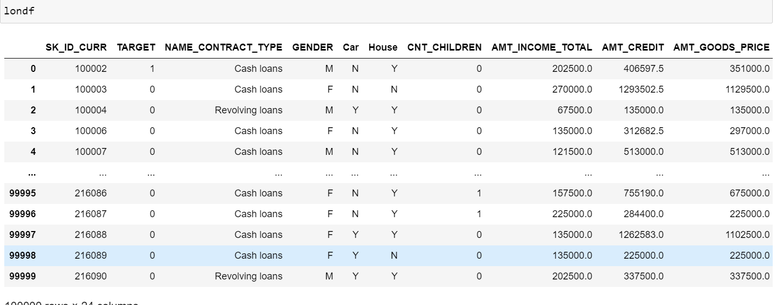
After Loading the given Dataset into a data frame called londf:
The below dataset contains: 100000 rows and 24 columns.

Slide 4
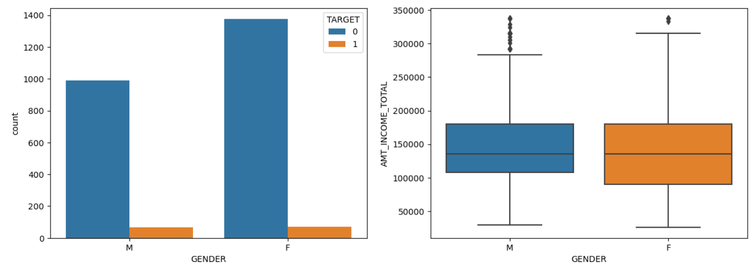


Slide 5
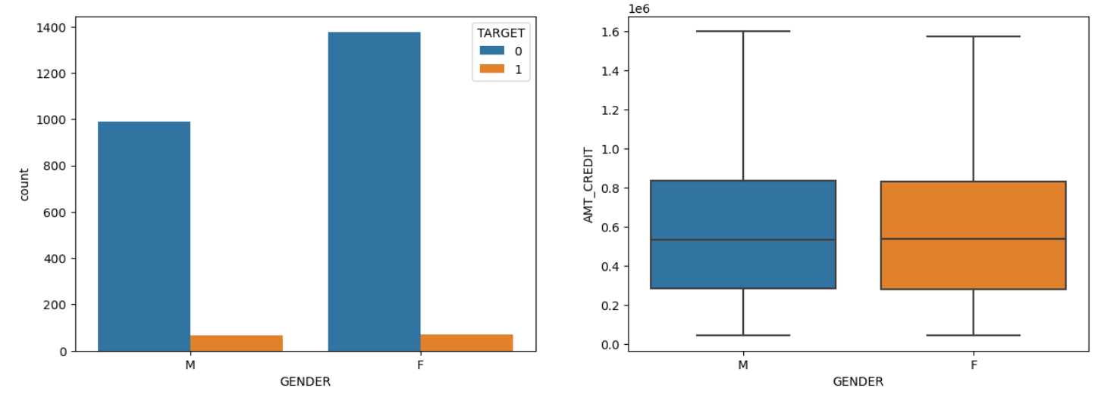


Slide 6
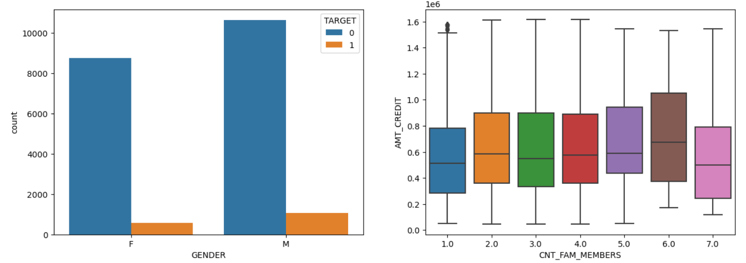


Slide 7
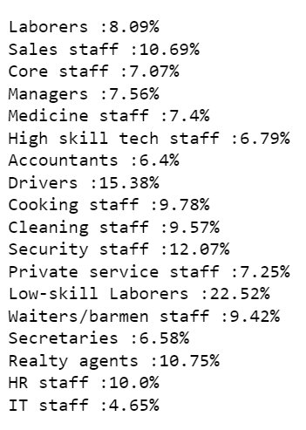
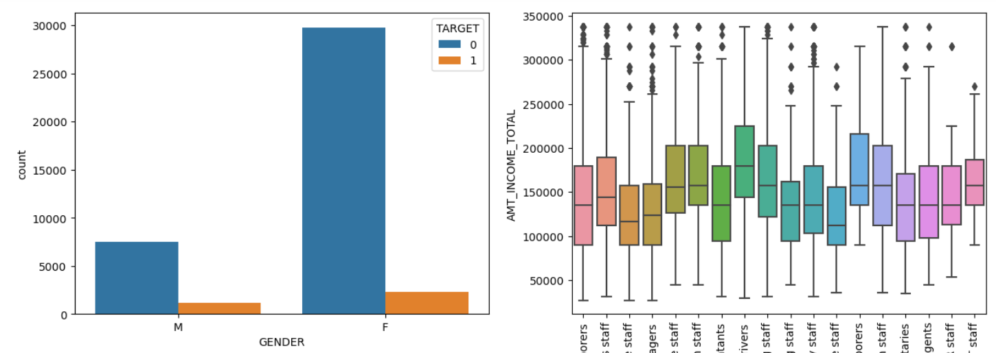

Slide 8
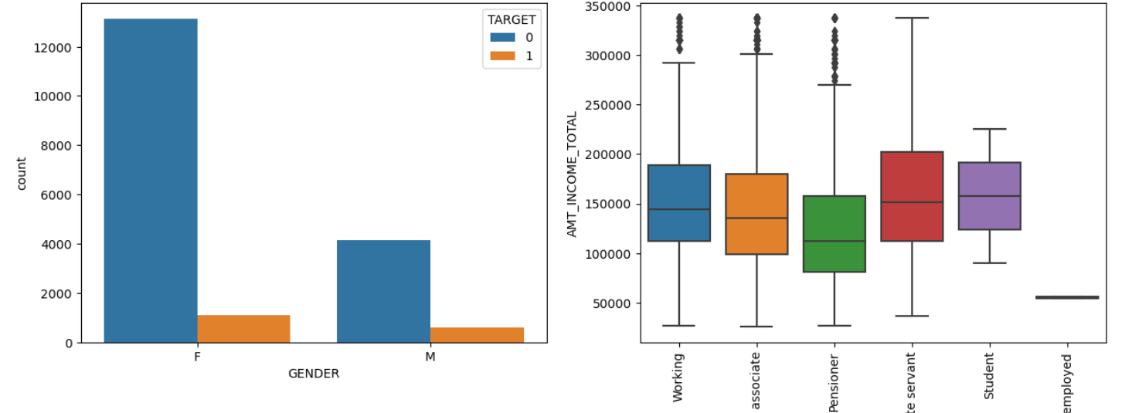
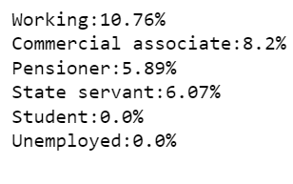

Slide 9
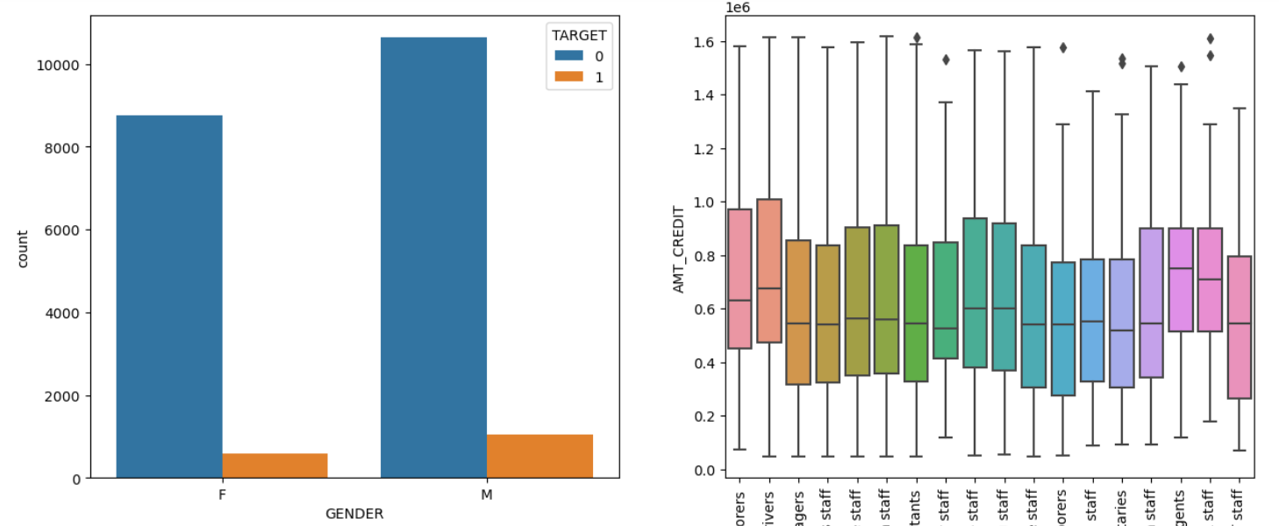
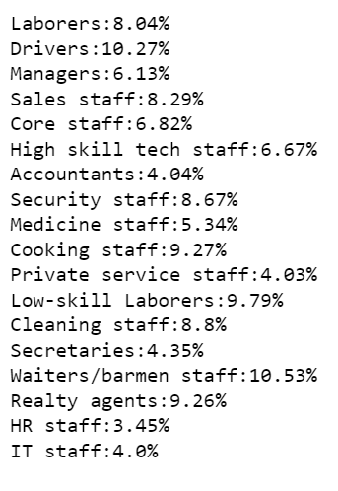

Slide 10
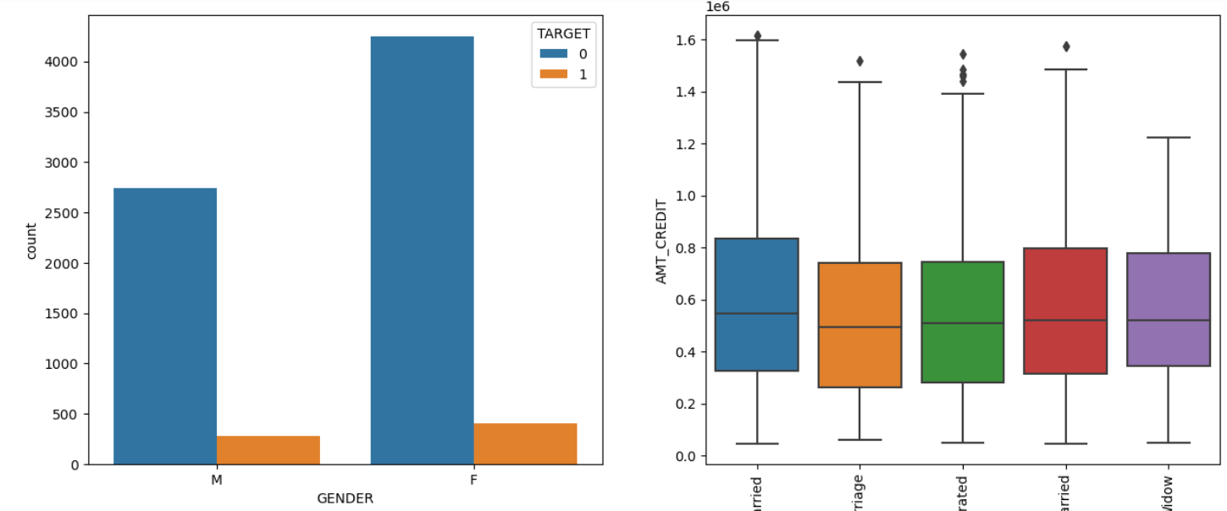
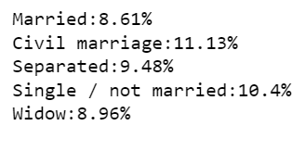

Slide 11
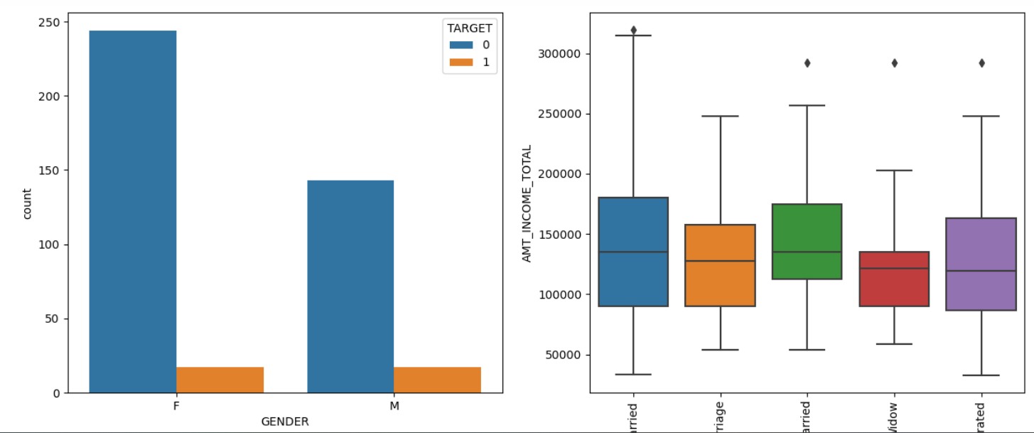
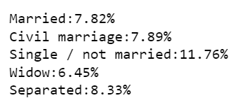

Slide 12
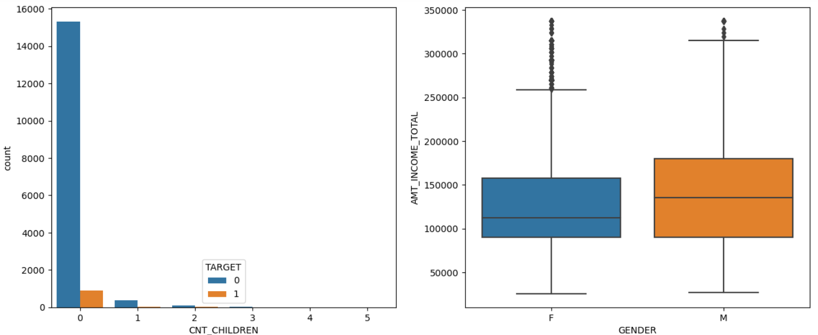


Slide 13
Overall Summary
People with a car and a house and with family members more than 2 can be given more credit and Males in this case are considered as possible defaulters.
2. People with cash loans , no car and a house with an occupation of low skill laborers , HR , Sales and Security Staff and Drivers who are Females are possible defaulters.
3. People with no car . no house and coming from a working class and commercial associates who are females are possible defaulters.
4. People with cash loan and 2 children having status of civil marriage and single are the possible defaulters whoe are females . Married status females can be given more credit.
5. People with only one child and are employed who are Male with status Single, Seperated are the possible defaulters . Married people have a higher income.

Slide 14
THANK YOU
BY-
ARJUN MAURYA

